Slide 1
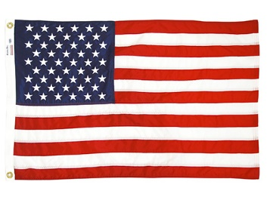
Insert images, clipart, text, or whatever you wish to include on the effect wheel. You can “save as” this document, delete the example images and text from the right, and insert your own.
Align the bottoms of the images or text towards the center of the wheel, as shown, right.
Once you have completed inserting and orienting your images, print onto overhead projector film that is appropriate for your printer.
Once dry, cut out effect wheel along outer circle.
Remove rubber ring from the edge of the blank effects wheel.
Insert effect wheel in-between the two sides, and replace rubber ring.
Insert your new effects wheel into the projector.
France
South Korea
Canada
Greece
United States
Israel
Note: Some printers may scale this document to a slightly different size. The large circle should be six inches in diameter and the inner circle 2”. Please adjust as necessary.

